Slide 1
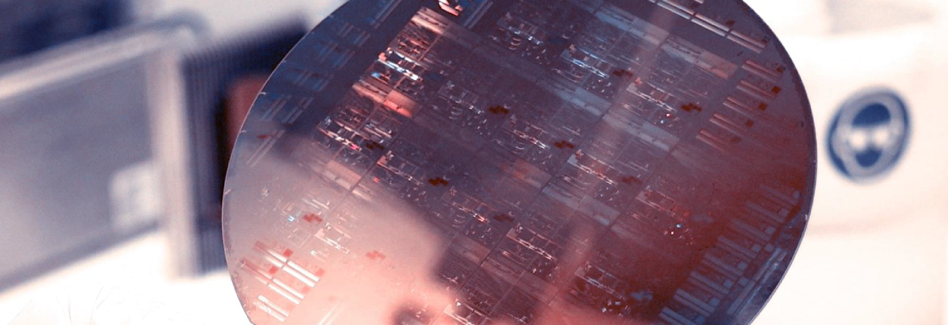
Lab Book 2.0. Couplers
Student:

Slide 2
Instructions General
SOFTWARE
Python notebook supplied by instructors
SCRIPTS
From Poliformat → download the 20_COUPLERS_v2025_Student.ipynb
Either run locally or at Google Collaboratory
Cross-Sections to be studied:
w (width)
w (width)
h
(height)
Core
Core
h
(height)
MMI Body
g
(gap)
Cladding
Cladding
Directional coupler (DC)
Multimode Interference (MMI) coupler

Slide 3
Directional coupler

Slide 4


Learning outcome #1 – Directional wavelength dependence Wavelengths from 1.5 to 1.7 µm, gap = 0.6 µm, width 1.0 µm
deep waveguide
Paste $L_{π}$ vs wvl for TE and TM plot here
shallow waveguide
Paste $L_{π}$ vs wvl for TE and TM plot here
slab = 150nm
Comment results

Slide 5


Learning outcome #2 – Directional coupler gap dependence Wavelength 1.55 µm, width 1.0 µm, gap 0.2-2.4 µm (step 0.2 µm)
deep waveguide
Paste $L_{π}$ vs gap for TE and TM plot here
shallow waveguide
Paste $L_{π}$ vs gap for TE and TM plot here
slab = 150nm
Make conclusions and observations from your results

Slide 6


Learning outcome #3 – Parallel uncoupled waveguides Wavelength 1.55 µm, width 1.0 µm, gap to be found for uncoupled wvgs
deep waveguide
Paste $K$ vs gap for 10 mm wvgs to be uncoupled
shallow waveguide
Paste $K$ vs gap for 10 mm wvgs to be uncoupled
Hints:
All waveguides running in parallel are coupled somehow. Controlling the degree of coupling is key for those waveguides you don’t want coupling over certain level (i.e. uncoupled waveguides). Uncoupled waveguide definition, we will use K<0.01. Parallel waveguide length = 10 mm (typical length of a chip). Find minimum gap shallow / deep w=1.0µm wvl 1.55 µm.

Slide 7
Multimode Interferometer (MMI) Coupler

Slide 8
Learning outcome #4 – MMI coupler wavelength dependence Wavelengths from 1.5 to 1.7 µm, wMMI = 6.6 µm
deep waveguide
Paste $L_{π}$ vs wvl for TE and TM plot here
shallow waveguide
Paste $L_{π}$ vs wvl for TE and TM plot here
slab = 150nm
Comment results (Important. Compare with Directional Coupler)

Slide 9


Learning outcome #5 – MMI coupler body width dependence Wavelength 1.55 µm, wMMI = 5-10 µm (steps 0.5 µm)
deep waveguide
Paste $L_{π}$ vs width for TE and TM plot here
shallow waveguide
Paste $L_{π}$ vs width for TE and TM plot here
slab = 150nm
Polarization independent coupler: is there any point for which the MMI coupler can work identically for TE and TM? Answer yes / no and explain why?

Slide 10
Learning outcome #6 – 2x2 Multimode Interference Coupler Wavelength 1.55 µm, wMMI = 6.6 µm
deep waveguide
Paste propagation plots and console results
Comment results (Coupling relationship, Lpi, losses, comparison with Directional Coupler… )

Slide 11
Learning outcome #7 – 2x2 Multimode Interference Coupler - Optimization Wavelength 1.55 µm, wMMI = 6.6 µm
deep waveguide
Paste propagation plot and console results
Target: make equal ratio over outputs (even if not 0.5) and minimize excess loss (even if not 0.0 dB)
With same settings of previous LO, now adjust try to manually optimize the MMI by changing iteratively:
- Change dL_MMI
- Change I/O waveguide position +/- dy
Hints: observe the 2D EME propagation results to guide you to the best settings of a) and b).
Comment results

Slide 12
Learning outcome #8 – 2x2 Multimode Interference Coupler – Optimization (II) Wavelength 1.55 µm, wMMI = 6.6 µm
deep waveguide
Paste propagation plot and console results
Target: make ratio over outputs 0.5 + excess loss < 0.1 dB
With same settings of previous LO, now modify the notebook so I/O waveguides have a different width.
- The nominal I/O waveguide width you have been using is 1.0 µm, increase it.
(Warning! Every time you change the I/O waveguide width you have to re-run modes calculation)
Hints: observe the 2D EME propagation results to guide you to the best settings of a) and b).
Comment results

Slide 13
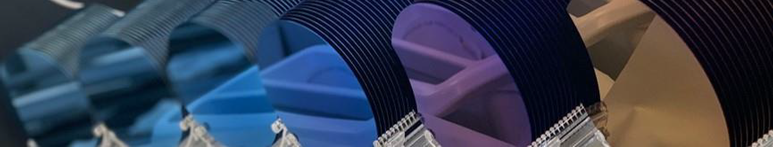
Thank you

